Slide 1
Pipelining and Hazards
CSE-3109 Computer Architecture
Lecture 17

Slide 2
The laundry analogy for pipelining
Four users have dirty clothes to be washed, dried, folded, and put away.
The washer, dryer, “folder,” and “storer” each take 30 minutes for their task.

Slide 3
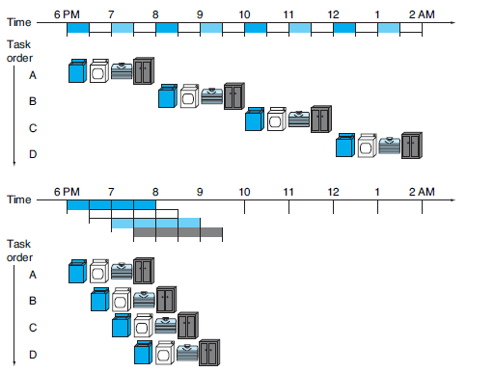
The laundry analogy for pipelining
Sequential laundry takes 8 hours for 4 loads of wash, while pipelined laundry takes just 3.5 hours.

Slide 4
MIPS Pipeline
Following are the 5 stages of the RISC pipeline with their respective operations:
Stage 1 (Instruction Fetch) In this stage the CPU reads instructions from the address in the memory whose value is present in the program counter.
Stage 2 (Instruction Decode) In this stage, instruction is decoded and the register file is accessed to get the values from the registers used in the instruction.
Stage 3 (Instruction Execute) In this stage, ALU operations are performed.
Stage 4 (Memory Access) In this stage, memory operands are read and written from/to the memory that is present in the instruction.
Stage 5 (Write Back) In this stage, computed/fetched value is written back to the register present in the instructions.

Slide 5
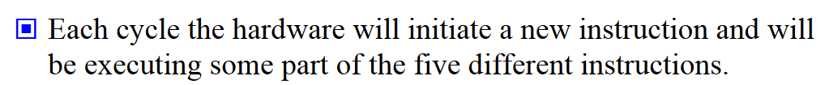
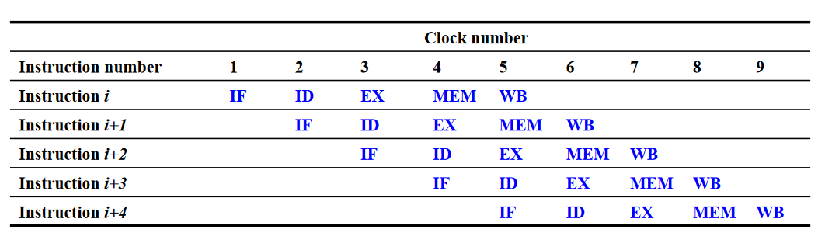
Classic 5-Stages Pipeline

Slide 6
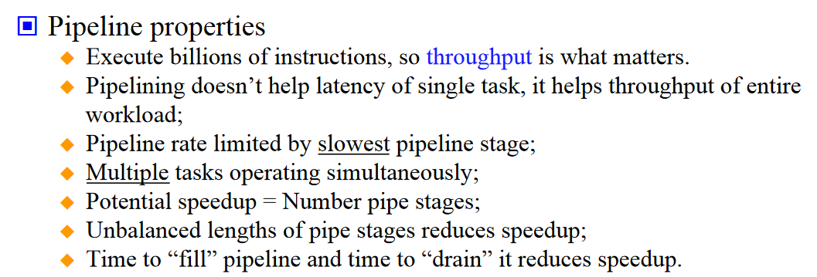
Computer Pipelines

Slide 7
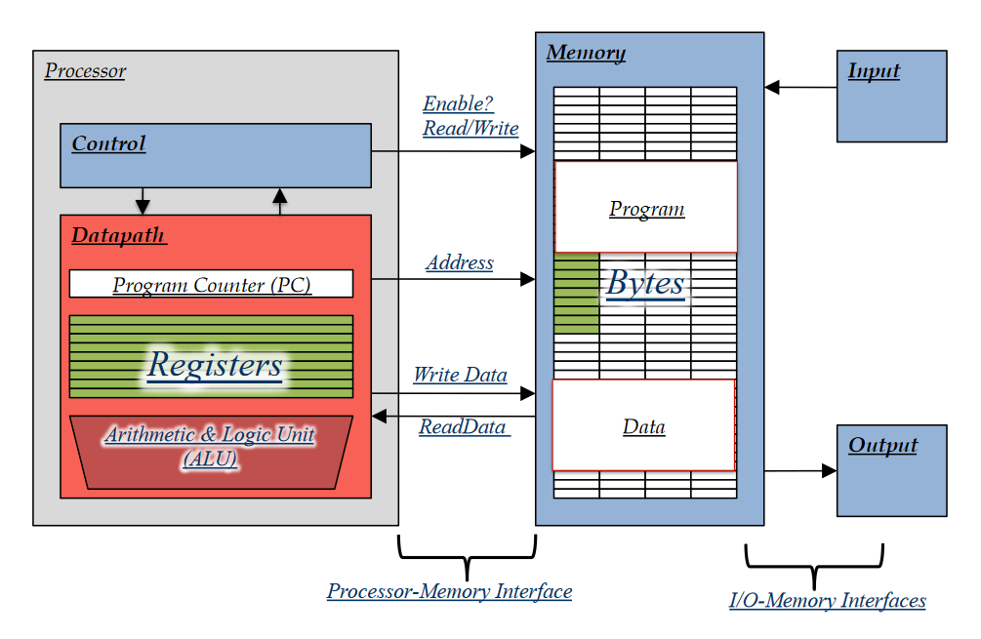
Reviews-Components of a computer

Slide 8
Reviews-Clock Cycle and Machine Cycle
The speed of a computer processor, or CPU, is determined by the clock cycle, which is the amount of time between two pulses of an oscillator . Generally speaking, the higher number of pulses per second, the faster the computer processor will be able to process information. The clock speed is measured in Hz, typically either megahertz (MHz
) or gigahertz (GHz). For example, a 4GHz processor performs 4,000,000,000 clock cycles per second.
Computer processors can execute one or more instructions per clock cycle, depending on the type of processor. Early computer processors and slower processors can only execute one instruction per clock cycle, but faster, more advanced processors can execute multiple instructions per clock cycle, processing data more efficiently.

Slide 9
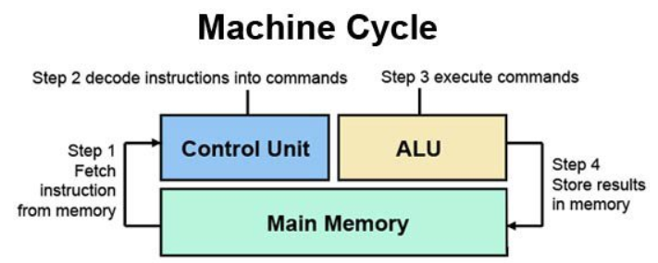
Reviews-Clock Cycle and Machine Cycle
The steps performed by the computer processor for each machine language instruction received. The machine cycle is a 4 process cycle that includes reading and interpreting the machine language, executing the code and then storing that code.

Slide 10
Reviews-Clock Cycle and Machine Cycle
Four steps of Machine cycle are:
Fetch: Retrieve an instruction from the memory.
Decode: Translate the retrieved instruction into a series of computer commands.
Execute: Execute the computer commands.
Memory Access: In this stage, memory operands are read and written from/to the memory that is present in the instruction.
Store: Send and write the results back in memory.

Slide 11
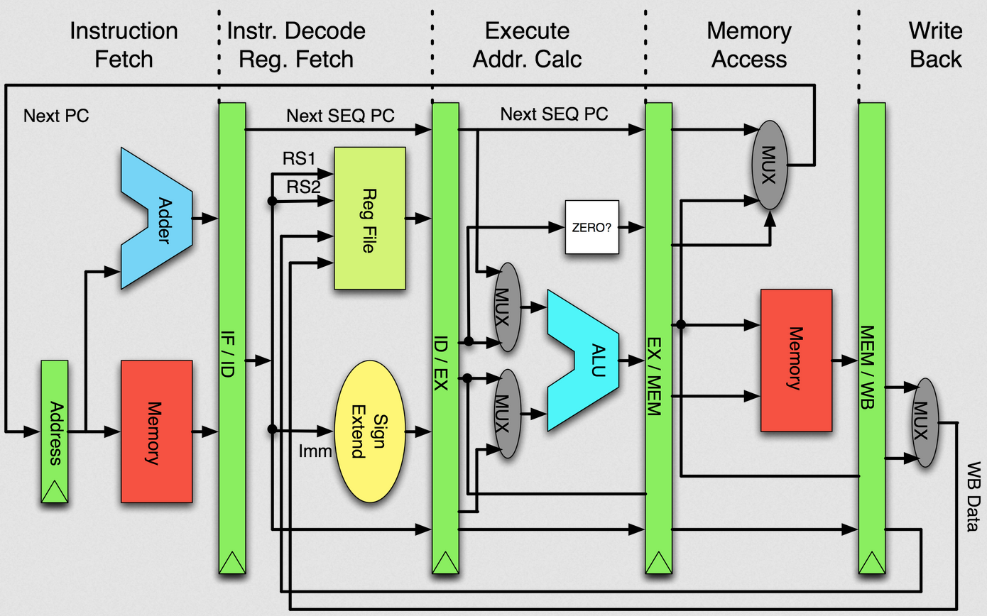
MIPS Pipeline
RS1, RS2, : Source Registers
Imm: Register Immediate
Ref: (Lecture 9)

Slide 12
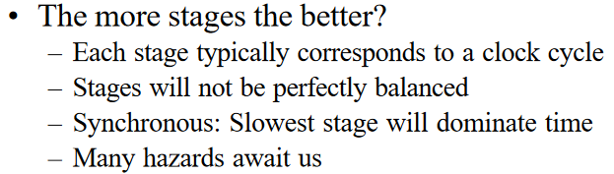
Speed Up of Pipelining
If the stages are perfectly balanced, then the time per instruction on the pipelined processor—assuming ideal conditions—is equal to

Slide 13
Pipelined Hazards
  Pipeline hazards are conditions that can occur in a pipelined machine that impede the execution of a subsequent instruction in a particular cycle for a variety of reasons.
  Hazards that arise in the pipeline prevent the next instruction from executing during its designated clock cycle.
  There are three different types of hazards:
  Structural Hazards
  Data Hazards
  Control Hazards

Slide 14
Structural Hazards
A structural hazard occurs when a part of the processor's hardware is needed by two or more instructions at the same time. A canonical example is a single memory unit that is accessed both in the fetch stage where an instruction is retrieved from memory, and the memory stage where data is written and/or read from memory.
A structural hazard occurs when two (or more) instructions that are already in pipeline need the same resource. The result is that instruction must be executed in series rather than parallel for a portion of pipeline. Structural hazards are sometime referred to as resource hazards.

Slide 15
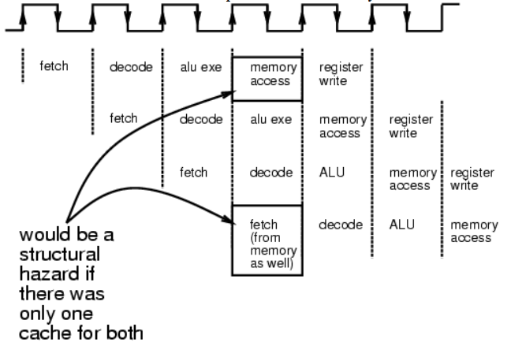
Structural Hazards

Slide 16
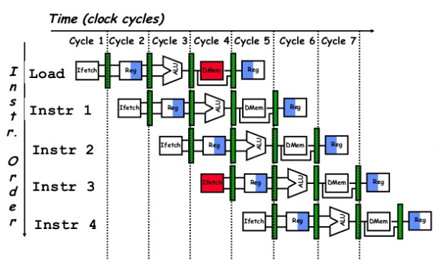

Structural Hazards
D Mem
Same Memory for instruction and Data

Slide 17
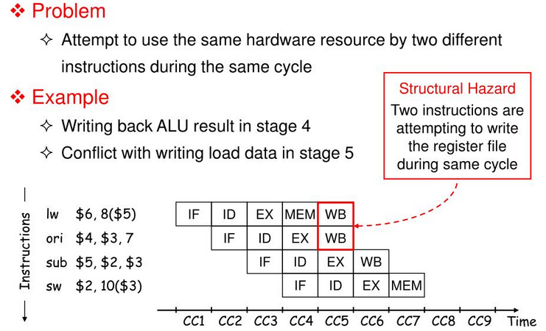
Structural Hazards

Slide 18
Structural Hazards
They can often be resolved
  by separating the component into orthogonal units (such as separate caches) or
  bubbling the pipeline.

Slide 19
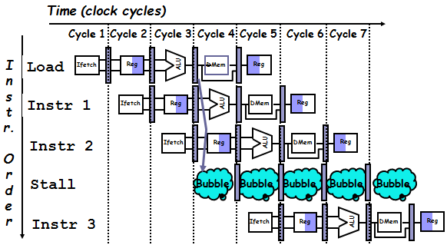
Resolving Structural Hazard
To resolve this, we stall the pipeline for one clock cycle when a data-memory access occurs. The effect of the stall is actually to occupy the resources for that instruction slot. Hence, In the design of pipelined computer processors, a pipeline stall is a delay in execution of an instruction in order to resolve a hazard.

Slide 20
Resolving Structural Hazard
A bubble represents a stage in the pipeline that cannot perform any useful work due to the lack of data from an earlier pipeline stage. When a particular pipeline stage has stalled, the CPU instructions that have already passed through the stage continue to move ahead and leave behind vacant stages or bubbles.

Slide 21
Renaming
The structural hazards are minimized using a hardware technique is used called renaming. The renaming mechanism states that it splits the memory into two independent sub-modules to store instruction and data separately. The module used to store instruction is called code memory (CM), and the module used to store data is called data memory(DM).
In this technique, as we proceed further, we refer to the code memory in the first stage and refer to the data memory next, so accessing these two memories in the same cycle does not create any conflict or hazard. In this manner, we eliminate structural hazards in pipelining.

Slide 22
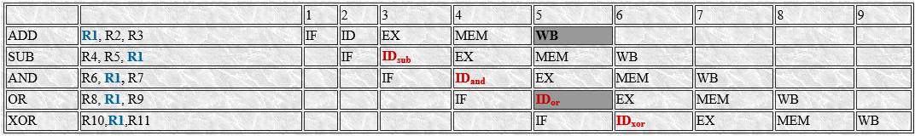
Data Hazard
Data hazards occur when the pipeline must be stalled because one step must wait for another to complete.
In a computer pipeline, data hazards arise from the dependence of one instruction on an earlier one that is still in the pipeline
Consider the pipelined execution of these instructions:

Slide 23
Data Hazard-continue
All the instructions after the ADD use the result of the ADD instruction (in R1). The ADD instruction writes the value of R1 in the WB stage (shown black), and the SUB instruction reads the value during ID stage (ID_{sub}). This problem is called a data hazard. Unless precautions are taken to prevent it, the SUB instruction will read the wrong value and try to use it.

Slide 24
Data Hazard-continue
The AND instruction (3rd row) is also affected by this data hazard. The write of R1 of first ADD instruction does not complete until the end of cycle 5 (shown black). Thus, the AND instruction that reads the registers during cycle 4 (ID_{and}) will receive the wrong result.
During OR instruction that reads the register during cycle 5(ID_{or}) will also receive the wrong result.
The XOR instruction operates properly, because its register read occur in cycle 6 after the register write by ADD.

Slide 25
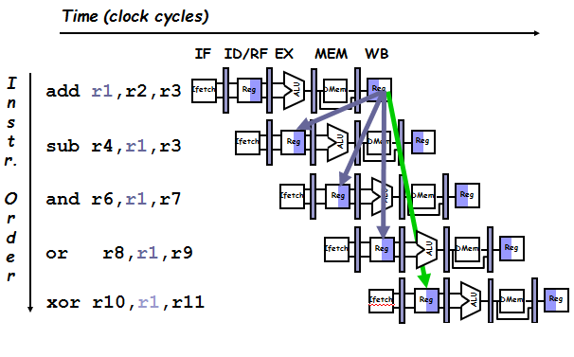
Data Hazard-continue

Slide 26
Solution of Data Hazard
The primary solution is based on the observation that we don’t need to wait for the instruction to complete before trying to resolve the data hazard.
For the code sequence above, as soon as the ALU creates the sum for the add, we can supply it as an input for the subtract.
Adding extra hardware to retrieve the missing item early from the internal resources is called forwarding or bypassing.

Slide 27
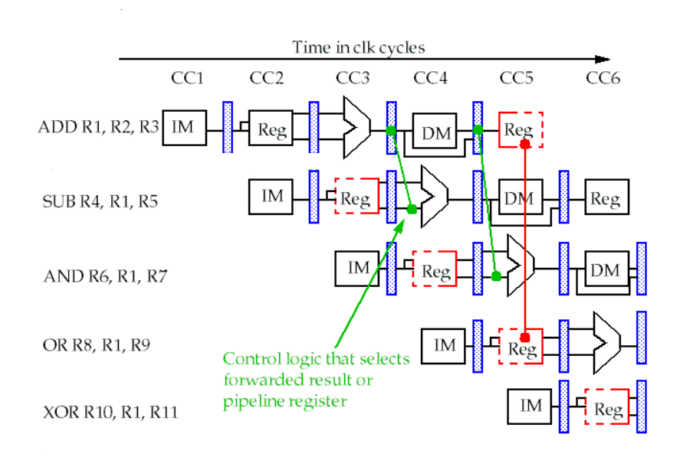
Forwarding or bypassing Data Hazard

Slide 28
Forwarding or bypassing Data Hazard
  A key observation is that the necessary register value is often available but is not in the right place, i.e. the register file.
  This occurs because of the structure of our pipeline.
  The fix: Allow the CPU to move a value directly from one instruction to another without going through the register file.
  The values are forwarded to future instructions.
    Note that they are actually moving backward in the datapath.

Slide 29
Forwarding or bypassing Data Hazard
ADD is writing to register in the same step that OR is reading from register, so there’s no guarantee that the correct value will be safe in the register at the point OR, ADD is allowed one full clock cycle to make that write and have the signals propagate throughout the hardware. By contrast, XOR is safe because it reads from R1 in the next clock cycle ADD’s write.

Slide 30
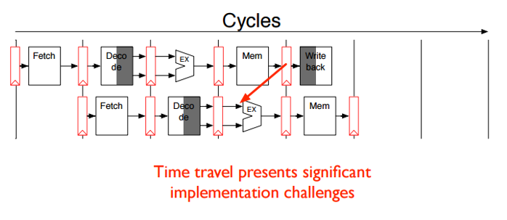

Data Hazard even with Forwarding (Load Data Hazard) (Case 1)
We cannot always prevent all stalls with forwarding. Consider the following instructions.Forwarding cannot prevent all pipeline stalls.
We need a stall even with forwarding when an instruction following a load tries to use the data. Without the stall, the path from memory access stage output to execution stage input would be going backward in time, which is impossible.

Slide 31
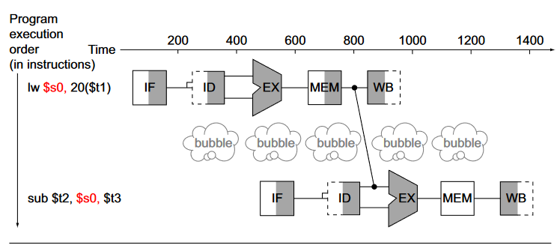
Data Hazard even with Forwarding (Load Data Hazard) (Case 1)-Solution
I we use forwarding, the new contents of $s0 are only available after load word’s MEM stage. So we’ll have to stall the sub instruction one cycle.

Slide 32
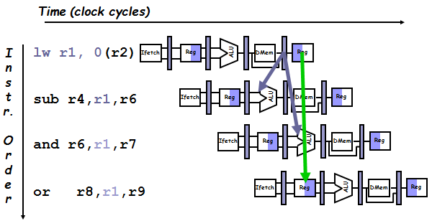
Data Hazard even with Forwarding (Load Data Hazard) (Case 2)
The desired data would be available only after the fourth stage of the first instruction in the dependence, which is too late for the input of the third stage of sub.

Slide 33
Resolving the Load Data Hazard (Case 2-Solution)
Stalling is necessary in this case for proper execution.
  This is done with a pipeline interlock , which stalls the pipeline until the hazard is cleared.
This inserts a bubble into the pipeline just as the structural hazard did.
  Just as with structural hazards, no instructions are started during the cycle in which the bubble is inserted.

Slide 34
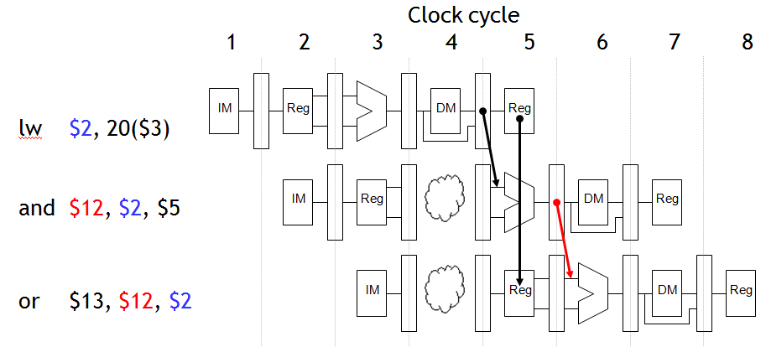
Resolving the Load Data Hazard

Slide 35
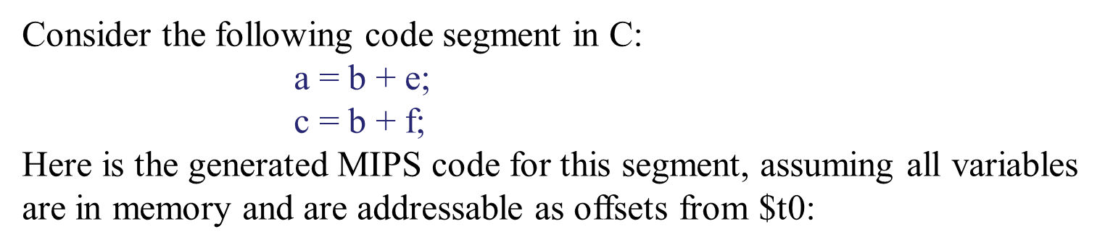
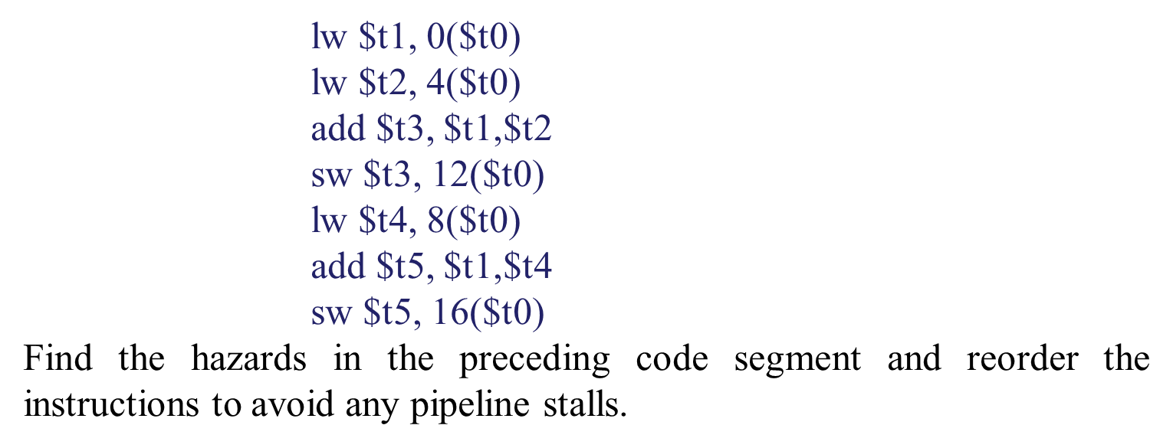
Home Work

Slide 36
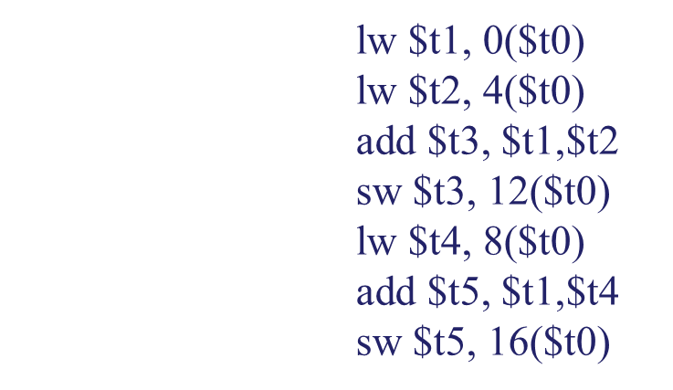
Reordering Code to avoid Pipeline Stalls
Both add instructions have a hazard because of their respective dependence on the immediately preceding lw instruction. Moving up the third lw instruction to become the third instruction eliminates both hazards:

Slide 37
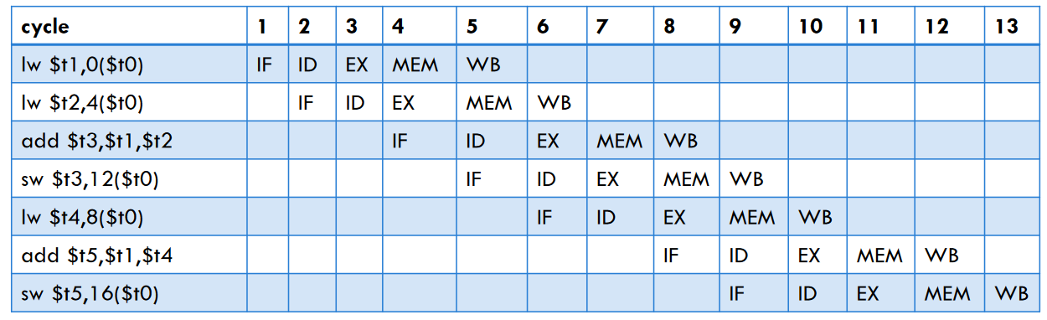
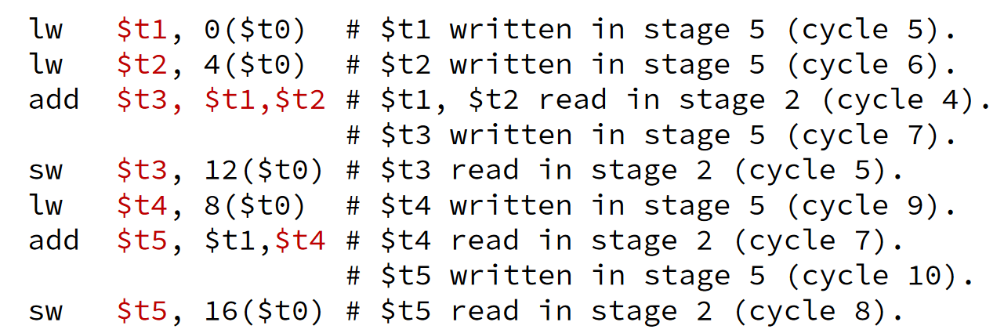
Solution
If we are using a pipelined processor with forwarding, we have the following stages executing in each cycle:

Slide 38
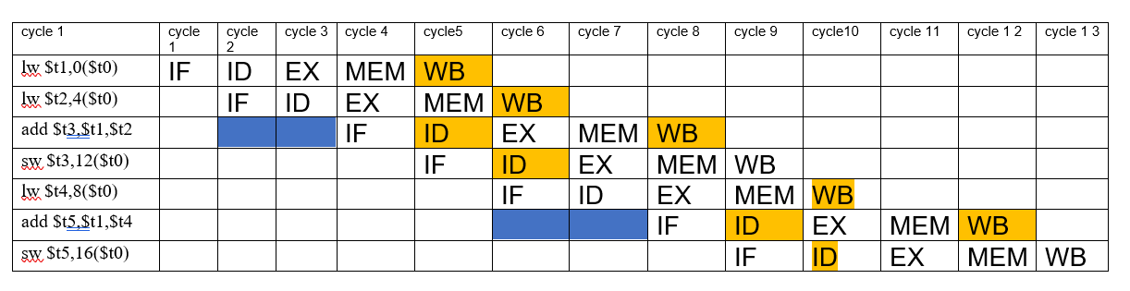
Solution
If we are using a pipelined processor with forwarding, we have the following stages executing in each cycle:

Slide 39
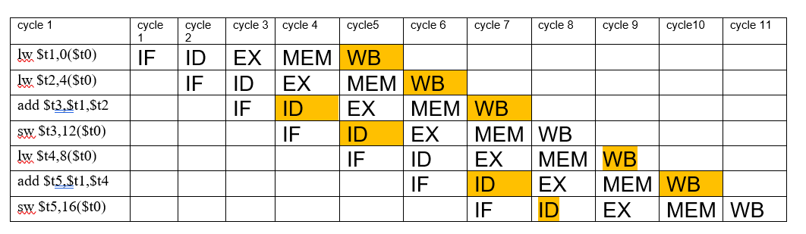
Solution
If we are using a pipelined processor without forwarding, we have the following stages executing in each cycle:
Correct it?

Slide 40
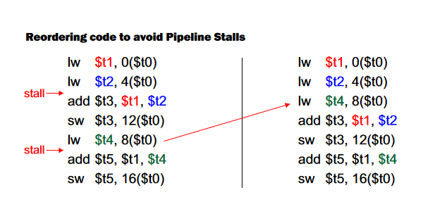
Reordering Code to avoid Pipeline Stalls

Slide 41
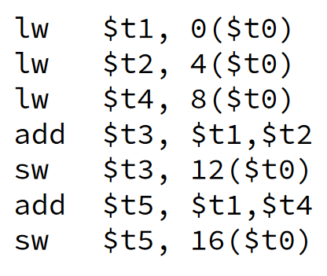
Reordering Code to avoid Pipeline Stalls
We can move the third load word instruction up since it has no dependencies from previous instructions.

Slide 42
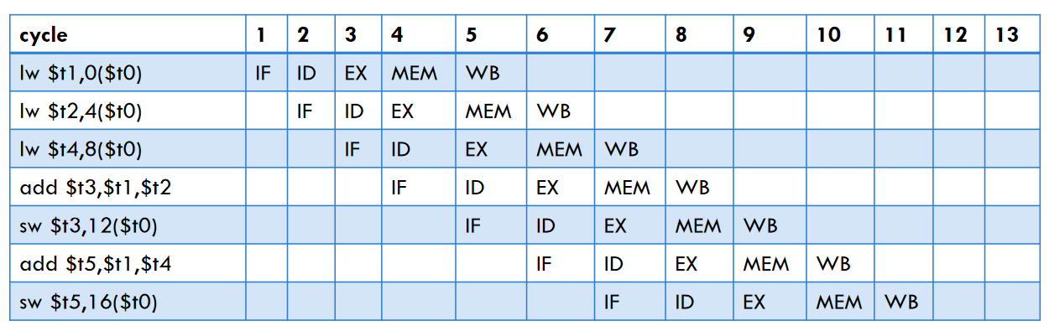
Reordering Code to avoid Pipeline Stalls
Complete it ??

Slide 43
Continue

